Slide 1

THERMAL PROPERTIES OF MATTER

Slide 2
TEMPERATURE AND HEAT

Slide 3

Heat and temperature :
Heat :
Heat is a form of energy transferred between two bodies due to difference in temperature.
Heat energy always flows from a body at high temperature to a body at low temperature.
HEAT FLOW
Higher Temperature
Lower Temperature

Slide 4

What is temperature?
TEMPERATURE:
Temperature is a physical quantity which measures the degree of hotness or coldness of a body.
It can also be defined as the thermal condition of a body which determines its ability to transfer heat to other bodies.
It is the property which determines the direction of flow of heat between two bodies in the thermal contact with each other.

Slide 5
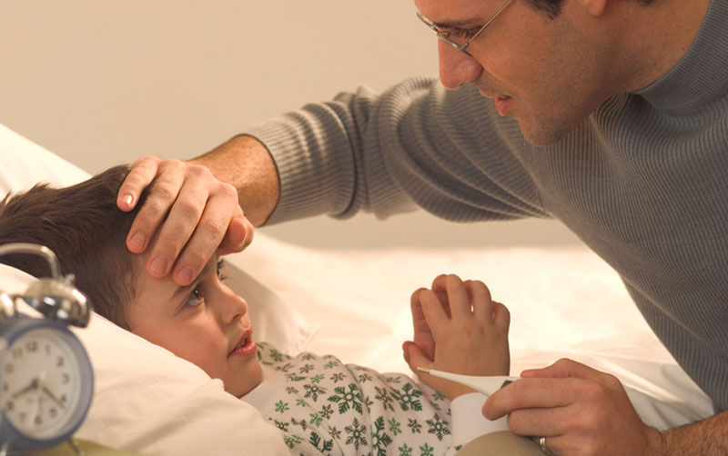
TEMPERATURE:
When two bodies are at the same temperature, then they are said to be in a thermal equilibrium with each other.
Temperature is the macroscopic property of a body or system.
Temperature is a scalar physical quantity..

Slide 6
Temperature is the thermal condition that determines the direction of heat flow. | Heat is energy transferred from higher temperature to lower temperature.
Temperature is average energy of the particles. | Heat is total energy of particles.
Temperature is degree of hotness. | Heat is the form of energy.
Unit of temperature is Celsius or Kelvin or Fahrenheit. | Unit of heat is Joule or Calorie.
TEMPERATURE
HEAT

Slide 7
MEASUREMENT OF TEMPERATURE

Slide 8
Measurement of Temperature:
The science of temperature and its measurement is called as thermometry.
An instrument designed to measure temperature is called as thermometer.
Thermo means:
Heat
Meter means:
Measuring device

Slide 9
Instrument
TEMPERATURE
Thermometer
SCALES
TYPES
1) Celsius scale
P-constant ⇒ ΔT is given by ΔV
2) Fahrenheit scale
V-constant ⇒ ΔT is given by ΔP
3) Kelvin scale
ΔT is given by ΔR
1) Liquid in glass thermometer
2) Constant volume gas thermometer
3) Resistance thermometer

Slide 10
Measurement of Temperature:
An objective measurement of temperature is based on the zeroth law of thermodynamics.
A device which measures temperature of a body is called thermometer.
Zeroth law of thermodynamics:
If two bodies A and B are in thermal equilibrium with a third body C separately then A and B are in thermal equilibrium with each other.

Slide 11
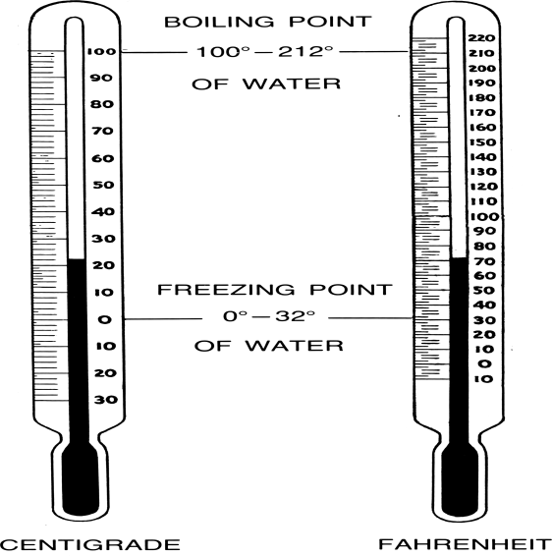

Slide 12
Measurement of temperature requires
The construction of an instrument. (i.e., thermometer)
The calibration of the thermometer.
Calibration of the thermometer depends on fixing certain points on the thermometer.

Slide 13
The ice point
melting point of ice
Under normal atmospheric pressure.
The steam point
Boiling point of water
The ice point and the steam point of water are known as freezing and boiling points of water.

Slide 14
IDEAL GAS EQUATION AND THE THREE SCALES OF TEMPERATURE

Slide 15
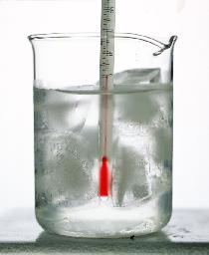
1) Celsius Scale
Scale
On the Celsius scale it is 0⁰C and 100⁰C.
Ice point
No.of divisions
0°C 32°F
100-0 = 100
212-32 = 180
Each division corresponds to
1°C 1°F
COOLING

Slide 16
2) Fahrenheit Scale
Steam point
The ice and steam point have values 32⁰F and 212⁰F respectively on the Fahrenheit scale
100 °C
212 °F
BOILING

Slide 17
Ideal gas equation
P : Pressure
PV
nRT
=
V : Volume
T : Temperature
n : No. of moles (remains constant)
R : Ideal gas constant (remains constant)

Slide 18
Liquid in gas thermometers shows different readings for temperatures other than the fixed points because of different expansion properties.
A thermometer that uses gas, gives the same readings regardless of which gas is used.
Where T = t + 273.15 ; t is the temperature in ºC
The variables that describe the behavior of a given quantity of gas are pressure, volume and temperature (P,V,T).
Experiments show that all gases at low densities exhibit same expansion behaviour.

Slide 19
3) Kelvin scale or absolute temperature scale:
Y=mX + C
Y=mX
At constant volume {P/T = constant}
-273.15 ºC is called absolute zero temperature and taken as 0 Kelvin. Here P = 0 and V = 0.
Gas A
P
P
Gas B
-273.15 ºC
or 0 Kelvin
When the temperature is held constant, the pressure and volume of gas are related as
PV = constant (Boyle’s law).
Gas C
-200
O
200
t (ºC)

Slide 20
3) Kelvin scale or absolute temperature scale:
At constant Pressure {V / T = constant}
Y=mX + C
Y=mX
V
Gas A
When the pressure is held constant, the volume of a quantity of the gas is related to the temperature as V/T = constant.
- 273.15 ºC
or 0 Kelvin
Gas B
Gas C
-200
O
200
t (ºC)

Slide 21
Comparison of 3 scales:
GENERAL FORMULA
Celsius scale
Kelvin scale
Fahrenheit scale

Slide 22
Comparison of 3 scales
K
⁰C
⁰F
Water boils
373.15
100
212
98.6
Body temperature
310.15
37
273.15
0
32
Water freezes
Mean
-273.15
-459.60
0
Absolute zero
Comparison of Kelvin, Celsius and Fahrenheit temperature scale.

Slide 23
THERMOMETRIC SCALES

Slide 24
What are LFP and UFP?
Calibration of thermometer:
Calibration of a thermometer depends on fixing certain points on the thermometer.
Ice point is taken as Lower Fixed Point(LFP) .
Steam point is taken as Upper Fixed Point(UFP).
Fundamental interval = UFP – LFP

Slide 25
Thermometric scale:
The fundamental interval is divided into equal parts .
Thermometric scales
Celsius(⁰C)
Rankine (R_{a})
Fahrenheit(⁰F)
Kelvin(K)
Reaumur(R)
The distance between the LFP and UFP of a thermometer is called the fundamental interval.
Fundamental Interval=(UFP)-(LFP)

Slide 26
Different thermometric scales
S.No | THERMETRIC SCALE | LEP | UFP | TOTAL NO OF DIVISIONS.
1 | Celsius Scale | 0° C | 100° | 100
2 | Fahrenheit Scale | 32°F | 212°F | 180
3 | Kelvin Scale | 273 K | 373 K | 100
4 | Reaumur Scale | 0°R | 80°R_{a} | 80
5 | Rankine Scale | 492 R | 672 R_{a} | 180

Slide 27
Relation between different thermometric scales,
On any thermometric Scale

Slide 28
Faulty thermometer :
If the reading on a faulty thermometer is ’X’ and its lower and upper fixed points are L and U respectively then
i) Correct reading on Celsius Scale is
ii) Correct reading on Fahrenheit scale is
iii) Correct reading on Kelvin scale is

Slide 29
TYPES OF THERMOMETERS

Slide 30
TYPES OF THERMOMETERS
Liquid thermometers
Gas thermometers
Vapour pressure thermometers
Radiation thermometers
Resistance thermometers
Thermoelectric thermometers

Slide 31
Among the thermometers with cylindrical and spherical bulbs, cylindrical is more sensitive because cylindrical shape has more surface area.
Alcohol thermometer is more sensitive than mercury thermometer as the expansion of alcohol is more than that of mercury.

Slide 32
Mercury is used as liquid in thermometer because ….
Mercury has low specific heat, low heat capacity and low vapour pressure.
The coefficient of real expansion is more.
Mercury is opaque and shines like silver.
Mercury does not wet the glass.

Slide 33
Gas thermometers are more sensitive than liquid thermometers because,
All gases have the same temperature coefficients.
For slight variation of temperature there will be a large expansion.
Even though there is an impurity in it, it does not affect temperature.

Slide 34
Nitrogen is used as thermometric substance for measuring temperatures upto 1500⁰C.
Helium is used as thermometric substance for measuring low temperatures below -200⁰C.

Slide 35
CW. Two thermometers x and y have fundamental intervals of 80º and 120º. When immersed in ice, they show the reading of 20⁰ and 30⁰. If y measures the temperature of a body as 120º the reading of x is
1. 59º 2. 65º 3. 75º 4. 80º

Slide 36
THERMAL EXPANSION OF SOLIDS

Slide 37
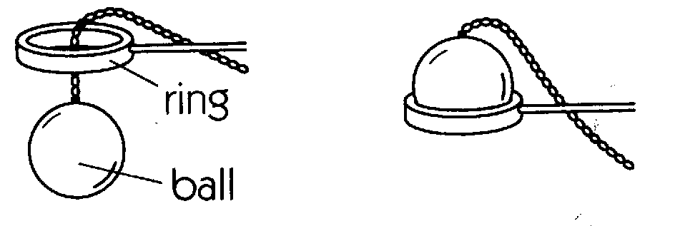
Thermal expansion of solids:
Solids have definite shape and size.
Solids expand on heating since interatomic distance between atoms increases with the increase in temperature.
The solids which expand uniformly in all directions on heating are called isotropic solids.
Solids are ISO-TROPIC

Slide 38
Thermal expansion of solids is different for isotropic and anisotropic solids.
Metals, amorphous solids like glass are the examples of isotropic solids.
Anisotropic solids have different thermal expansions in different directions.
Ex:
Cristiana (CaCo₃), and Galena.

Slide 39
Can a substance contract on heating?
Solid substances such as cast iron, silver iodine, silica glass, rubber, leather, ice, lead etc., contract on heating.

Slide 40
The molecules possess both K.E and P.E. So, the K.E and P.E of molecules increase when the body is heated.
The increase in K.E may be in
Translatory K.E
Rotatory K.E
Vibratory K.E
In solids the increase in K.E is in vibratory K.E and rotatory K.E.
The increase of K.E results in rise in temperature.

Slide 41
Potential energy curve:
Hence, the atoms acquire potential energy.
At a particular distance of separation the force of attraction is maximum-imparting minimum potential energy and acquire stability.
At equilibrium the atoms are in a specific state of vibration, at a particular distance of separation (r₀), making solid to have a definite size.
It is due to the presence of intermolecular attraction that the molecules possess P.E.
There exists a force of attraction between the atoms depending on the distance between them.
The atoms in a solid are arranged in a regular order called lattice.

Slide 42
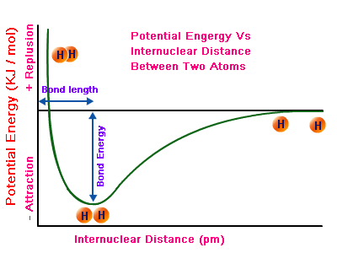
The graph between the interatomic distance and potential energy is a curve called potential energy curve.

Slide 43
COEFFICIENT OF LINEAR EXPANSION

Slide 44
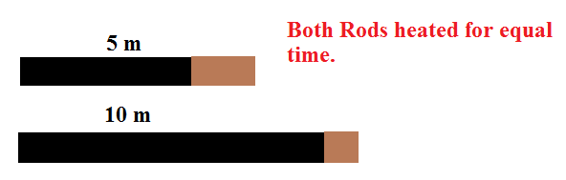
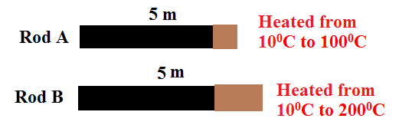
Coefficient of linear expansion (α ):
When a solid is heated, the increase in length is called linear expansion.
The ratio of increase in length of a solid per degree rise in temperature to its original length is called coefficient of linear expansion (α).

Slide 45
If l₁ and l₂ are the lengths of a rod at two temperatures t₁⁰C and t₂⁰C respectively, and the rise in temperature of the rod is (t₂-t₁)⁰C then coefficient of linear expansion is,
or
The SI unit of α is K⁻¹ and its CGS unit is (⁰C )⁻¹ .
The dimensional formula of α is [M⁰L⁰ T⁰ K⁻¹].

Slide 46
The coefficient of linear expansion of a solid depends on the nature of the material and scale of temperature.
Ex:
Iron -α = 12 × 10⁻⁶/⁰C
Copper -α = 17 × 10⁻⁶/⁰C
Brass -α = 18 × 10⁻⁶/⁰C
The linear expansion of a solid depends on three factors.
a) Its original length (l₁)
b) The nature of the material (α)
c) Change in temperature (t₂ – t₁)

Slide 47
Final length l₂ = l₁[1 + α (t₂ - t₁)]
Change in length l₂ - l₁= Δl = αl₁ (t₂ - t₁)
Final temperature t₂ = + t₁
Percentage change in length
Δl
×
100
= α (Δt) ×100
l

Slide 48
COEFFICIENT OF AREAL EXPANSION

Slide 49
Coefficient of areal or superficial expansion of a solid:
It is defined as the increase in area of a solid per unit original area per unit rise in temperature.
HEAT
a₁ → t₁°C
a₂ → t₂°C

Slide 50
If a₁ and a₂ are the areas of a solid at temperatures t₁ and t₂ respectively, then coefficient of areal expansion is given by
The SI unit β is K⁻¹ and its CGS unit is (⁰C)⁻¹ .
The dimensional formula of β is [M⁰L⁰T⁰K⁻¹]

Slide 51
Final area a₂ = a₁[1 + β (t₂-t₁)]
Final change in area Δa =βa₁(t₂-t₁)
Final temperature t₂ = + t₁
Change in area Δa = βa₁(t₂-t₁)
Percentage of fractional change in area Δa/a×100 = β(∆t)×100

Slide 52
The diameter of a metal ring is ‘D’ and the coefficient of areal expansion is β. If the temperature of the ring is increased by 1⁰C then
a) The increase in area of the ring
b) The increase in area of the ring
(Since β = 2 α)

Slide 53
For anisotropic solids, if α_{x,}α_{y} and α_{z} are coefficients of linear expansions along X,Y and Z directions respectively then the coefficient of areal expansion is,
For isotropic solids, β=2α.

Slide 54
COEFFICIENT OF CUBICAL EXPANSION

Slide 55


Coefficient of volume or cubical expansion of a solid:
It is defined as the increase in volume of a solid per unit original volume per unit rise in temperature.
HEAT
V₁→t₁°C
V₂→t₂°C

Slide 56
If V₁ and V₂ are the volume of a solid at temperature t₁ and t₂ respectively, then coefficient of cubical expansion is given by,
or

Slide 57
The SI unit of γ is K⁻¹ and its CGS unit is (⁰C)⁻¹.
The dimensional formula of is [M⁰ L⁰ T⁰ K⁻¹].
Final volume V₂ = V₁[ 1 + γ ( t₂ - t₁ )]
Final temperature, t₂ = + t₁

Slide 58
Change in area ΔV = γ V ( t₂ - t₁)
Percentage change in volume =
For isotropic solids, γ=3α
( ∵ α_{x} = α_{y} = α_{z} = α)

Slide 59
Relation between α, β and γ:
i) β = 2α
ii) γ = 3α
iii) α + β = γ
iv) α : β : γ = 1 : 2 : 3
v)
vi) The values of α, β and γ are independent of units of length, area and volume respectively.

Slide 60
Variation of density of a substance with temperature:
The volume of a solid increases on heating while its mass remains constant, hence the density of the substance decreases.
Let a solid of mass ‘m’ has volumes V₁ and V₂ and densities d₁ and d₂ at temperatures t₁⁰c and t₂⁰c respectively.
Where γ is coefficient of volume expansion of solid.
Hence,
M = V₁d₁= V₂d₂
∴V₁d₁=V₂d₂ …………..(1)
We know that, V₂ = V₁ [1+ γ (t₂ –t₁)]…(2)

Slide 61
Then V₁d₁ = V₁ [1+ γ (t₂ - t₁) ] d₂
Substituting equation (2) in (1)
d₁ =d₂ [1+γ (t₂ - t₁)]
If the solid is heated from 0⁰c to t⁰c then its density changes from d₀ to d_{t.}
(Since β = 2α)
d₀ =d_{t} [1+γ t]

Slide 62
THERMAL EXPANSION OF LIQUIDS

Slide 63
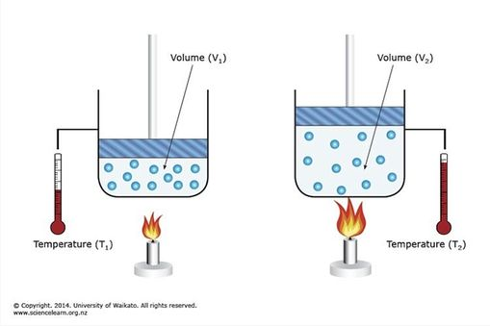
THERMAL EXPANSION OF LIQUIDS
Liquids have only volume but no definite shape of their own. So liquids have only volume expansion on heating.
Solids can be heated directly, but liquids can not be heated directly. Liquids are to be taken in a container and then heated.

Slide 64
When a liquid in a container is heated, both the liquid and the container expand.
Hence, in the case of liquids there are two types of expansions. They are
1) Apparent expansion.
2) Absolute or real expansion.

Slide 65
Apparent expansion:
When a liquid is heated in a container the observed change in volume of the liquid relative to the container is called the apparent expansion of the liquid.

Slide 66
Apparent expansion of the liquid depends on
a) Nature of liquid.
b) Nature of material of container.
c) Initial volume of the liquid.
d) Change in temperature.

Slide 67
Coefficient of apparent expansion of a liquid:
The ratio of apparent increase in volume of a liquid per unit rise of temperature to the original volume is called coefficient of apparent expansion.
It is measured in K⁻¹ or ºC⁻¹

Slide 68
V₁ be the initial volume of liquid at temperature t₁⁰C.
V₂ be the initial volume of liquid at temperature t₂⁰C.
γ_{a} is called coefficient of apparent expansion of the liquid.

Slide 69
Real or absolute expansion:
When a liquid is heated in a container the real change in volume of the liquid is called the real or absolute expansion of the liquid.

Slide 70
The real expansion of the liquid depends on
Nature of liquid.
Change in temperature.
Initial volume of the liquid.

Slide 71
Coefficient of real or absolute expansion of a liquid:
The ratio of real increase in volume of a liquid per unit rise of temperature to the original volume is called coefficient of real or absolute expansion.
γ_{r} – Coefficient of real expansion.
It is measured in K⁻¹ or / ºC

Slide 72
COMPARISON OF EXPANSIONS OF SOLID AND LIQUID

Slide 73
Comparison of expansions of solid and liquid:
Expansion of solids is almost uniform in any temperature range whereas liquids expand at different rates in different ranges of temperature.
Solids can have linear, superficial and volume expansions but liquids have only volume expansion.
The coefficient of volume expansion of liquids are generally several hundred times greater than those of solids.

Slide 74
The numerical value of γ_{a} and γ_{r} in unit per ⁰F is 5/9 times its numerical value in unit per ⁰C.
The relation between C and F is C/5 = (F-32)/9.

Slide 75
When a liquid is taken in a container and heated, the unoccupied volume over the liquid remains constant at all temperatures.
Then V_{c} γ_{c} = V_{r} γ_{r}
γ_{c} = coefficient of volume expansion of container.
γ_{l} = coefficient of real expansion of liquid.
V_{c} = volume of the container
V_{l} = volume of the liquid.

Slide 76
Variation in density of a liquid with temperature:
Consider liquid of mass ‘m’.
Let ρ_{o} be the density of the liquid at t₁= 0⁰C
Let ρ_{t} be the density of the liquid at t₂= t⁰C
ρ_{o}= ρ_{t} [ 1 + γ_{r} ( t )]
Hence, density of a liquid decreases with increasing temperature.

Slide 77
EXPANSION OF GASES

Slide 78
EXPANSION OF GASES
Gases have no definite shape and size of their own like solids, but completely occupy the entire volume of the vessel into which they are introduced irrespective of their mass.
For gases the co-efficients of linear and areal expansions have no significance.

Slide 79
When gas in a container is heated because of high expansion of the gases, we usually neglect the expansion of the container .
When gas is heated, its pressure and volume change simultaneously. This is not convenient to measure the two variations at a time.
When gas is heated, the variation in its volume can be measured by keeping its pressure constant.

Slide 80
Gas has two co-efficients
Volume
co-efficient of Gas(α)
Pressure
co-efficient of Gas (β)

Slide 81
Volume co-efficient of gas(α):
Volume co-efficient of Gas is defined as the increase in volume of given mass of a gas per volume at 0⁰C per degree Celsius rise in temperature keeping pressure constant.
If v₀ and v_{t} are the volumes of given mass of a gas at 0⁰C and t⁰C respectively at constant pressure, then

Slide 82
If v₁ and v₂ are the volumes of a given mass of a gas at t₁⁰C and t₂⁰c respectively at constant pressure then

Slide 83
(i) The unit of volume co-efficient of gas is K⁻¹ or / ⁰C
(ii) The dimensiona1 formula of volume co-efficient of a gas is [M⁰ L⁰ T⁰ K⁻¹]
(iii) The value of α is or 0.00366/°C is almost for all gases.

Slide 84
Pressure co-efficient of gas (β):
Pressure co-efficient of a gas is defined as the increase in pressure of given mass of a gas per pressure at 0⁰C per degree Celsius rise in temperature, keeping volume constant.
If p₀ and p_{t} are the pressures of given mass of gas at 0⁰C and t⁰C respectively at constant volume then,

Slide 85
If p₁ and p₂ are the pressures of given mass of a gas at t₁⁰c and t₂⁰c respectively at constant volume, then

Slide 86
(i) The unit of pressure co-efficient of gas is K⁻¹or ⁰C⁻¹
(ii) The dimensional formula of pressure co-efficient of gas [M⁰L⁰ T⁰ K⁻¹ ].
(iii) The value of β is or 0.00366/°C. It is almost constant for all gases.

Slide 87
APPLICATIONS OF THERMAL EXPANSION

Slide 88
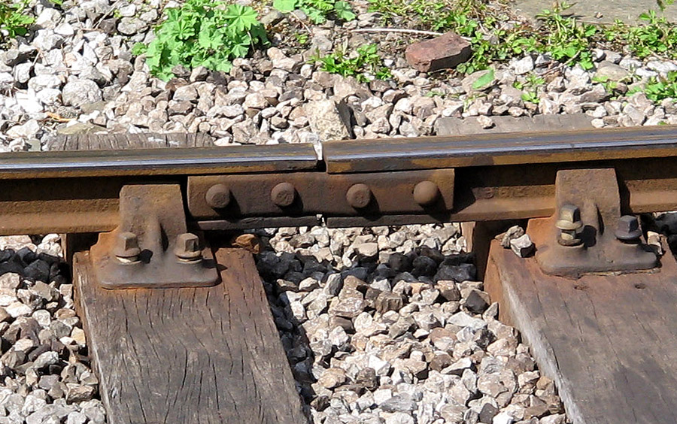
Examples of thermal expansion of solids in a daily life:
While laying the railway tracks, small gaps are left between adjacent rails to prevent the line from buckling even breaking due to changes of temperature.
The gap that should be left ∆l =l α (∆t)
gap
Oval shape bolts

Slide 89
Gaps are left along the length of cement roads to allow for expansion during summer.
To fix iron tyre onto the wooden rim of a cart wheel, the iron tyre is heated so that it slips onto the wooden rim. On cooling the iron tyre contracts and grips the wheel firmly.
Platinum wires are fused into glass without any risk of a crack developing since the coefficient of linear expansions of platinum and glass are same.

Slide 90
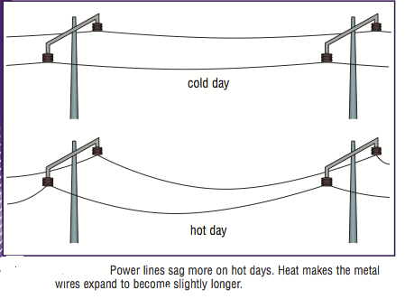
Wires between two electrical poles are loosely stretched to allow for contraction during winter season.
The expansion of steel is equal to that of concrete for same rise of temperature. Hence steel and concrete are used in the construction of buildings.

Slide 91
When hot water is taken in a glass tumbler it breaks due to uneven expansion.
When cold water drop falls on a hot chimney it breaks due to uneven contraction.

Slide 92
BIMETALIC STRIP, MEASURING TAPE AND PENDULUM CLOCK

Slide 93
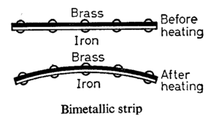
Bimetallic strip:
A bimetallic strip consists of two strips made of two different metals with different coefficients of expansion riveted together.
It works on the principle of different metals expand differently for the same rise of temperature.

Slide 94
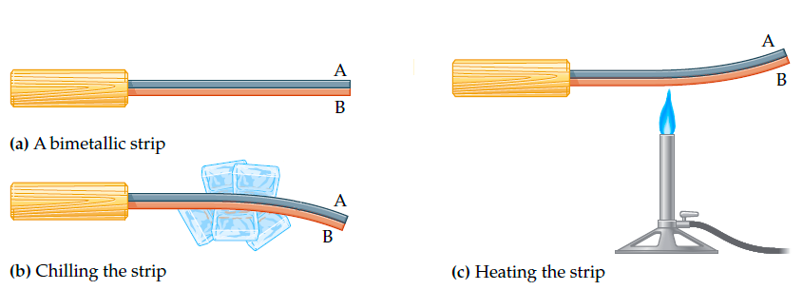
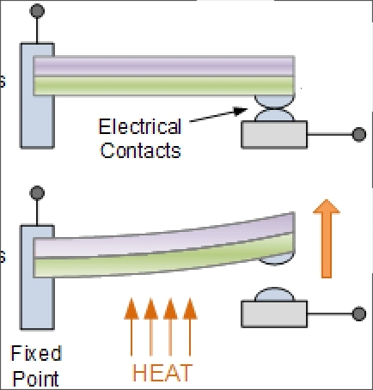
Bimetallic strip is made by riveting two metal strips, usually one of it is brass and the other is steel.

Slide 95
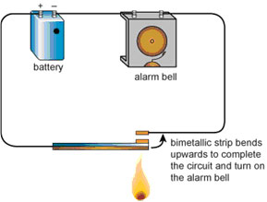
Uses:
For continuous recording of temperature
As a thermostat to control the temperature of a body(in refrigerator, iron box) .
As a fire alarm.
A bimetallic strip is used in a circuit of an fire alarm.

Slide 96
When bimetallic strip is heated brass expands more than steel, so the bimetallic strip bends with the brass on the outer side.
Steel
Brass
Room temperature
Steel
Steel
When a bimetallic strip is cooled, brass contracts more than steel. So bimetallic strip bends with brass on the inner side
Brass
Brass
Higher temperature
Lower temperature

Slide 97
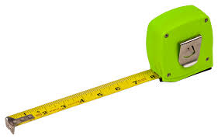
Measuring tapes:
Measuring tapes are made of invar steel because of its least coefficient of linear expansion.
Measuring tapes made of metals show correct reading only at a temperature at which they are constructed.
Measuring tape

Slide 98
A metal tape is graduated at t₁⁰C. If the measurement is taken at temperature t₂⁰C then distance between the divisions changes due to linear expansion of scale.
Thus, the measured reading will be different from correct reading.
If l_{m} is the measured reading of the length of a body and l_{o} is the correct length of the body at t₁⁰C then
Where α_{s} , α_{b} are the coefficients of linear expansions of the scale and the body respectively.
l₀ = l_{m} [1 + ( α_{s}- α_{b}) (t₂-t₁)]

Slide 99

Pendulum clock:
The period of a pendulum of length l is given by
In summer length of a pendulum increases so that its time period increases and it makes less number of oscillations than the required oscillations per day.
Hence , the pendulum clock loses time and runs slow.

Slide 100
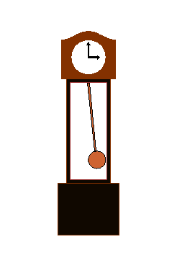
In winter length of a pendulum decreases so that its time period decreases and it makes more number of oscillations than the required oscillations per day.
Pendulum made of invar steel
Hence , the pendulum clock gains time and runs fast.
Pendulum clock

Slide 101
The fractional change in time period
Loss or gain in time per day=1/2 (αΔt) 86400 seconds.
= 43,200 α Δt seconds.
Percentage of time loss or gained
Pendulum clocks are made of invar steel because of its least coefficient of linear expansion.

Slide 102
CW. The coefficient of linear expansion of brass and steel are α₁ And α₂. If we take a brass rod of length l₁ and steel rod of length l₂ at 0ºC,their difference in length (l₂-l₁) will remain the same at a temperature if
1. 2.
3. 4.

Slide 103
CW. A steel scale is to be prepared such that the millimeter intervals are to be accurate within 6x10⁻⁵mm. The maximum temperature variation from the temperature of calibration during the reading of the millimeter marks is ( α = 12 x 10⁻⁶k⁻¹)
1. 4.0ºC 2. 4.5 ºC
3. 5.0 ºC 4. 5.5 ºC

Slide 104
CW. If is the moment of inertia of a solid body having - ΔT coefficient of linear expansion then the change in I corresponding to a small change in temperature is
1. 2.
3. 4.

Slide 105
CW. A metallic wire of length L is fixed between two rigid supports. If the wire is cooled through a temperature difference (Y=young’s modulus, = density, α = coefficient of linear expansion) then the frequency of transverse vibration is proportional to
1. 2.
3. 4.

Slide 106
CW. A steel tape gives correct measurement at 20ºC. A piece of wood is being measured with the steel tape at 0ºC. The reading is 25 cm on the tape, the real length of the given piece of wood must be
1. 25 cm 2. <25 cm
3. >25 cm 4. Can not say

Slide 107
CW. A sphere of diameter 7 cm and mass 266.5 gm floats in a bath of a liquid. As the temperature is raised, the sphere just begins to sink at a temperature 35ºC. If the density of a liquid at 0ºC is 1.527 gm/cc, then neglecting the expansion of the sphere the coefficient of cubical expansion of the liquid is f
1. 8.486 x 10⁻⁴ per ºC 2. 8.486 10⁻⁵ per ºC
3. 8.486 X 10⁻⁶ per ºC 4. 8.486 x 10⁻³per ºC

Slide 108
CW. A liquid with coefficient of volume expansion is filled in a container of a material having the coefficient of linear expansion α. If the liquid overflows on heating, then
1. 2.
3. 4. None of these

Slide 109

CW. Two rods having length l₁ and l₂ made of materials with the linear coefficient of expansion α₁and α₂, were welded together. The equivalent coefficients of linear expansion for the obtained rod
1. 2.
3. 4.

Slide 110
CW. An open vessel is filled completely with oil which has same coefficient of volume expansion as that of the vessel. On heating both oil and vessel,
1. the vessel can contain more volume and more mass of oil
2. the vessel can contain same volume and same mass of oil
3. the vessel can contain same volume but more mass of oil
4. the vessel can contain more volume but same mass of oil

Slide 111
CW. A metal ball immersed in Alcohol weights W₁ at 0ºC and W₂ at 50ºC. The coefficient of cubical expansion of the metal ( )_{Al}. Assuming that density of metal is large compared to that of alcohol, it can be shown that
1. W₁>W₂ 2. W₁ = W₂
3. W₁<W₂ 4. any of (1), (2) or (3)
CW. The volume thermal expansion coefficient of an ideal gas at constant pressure is
1. T 2. T² 3. 4.

Slide 112
CW. A thin copper wire of length L increase in length by 1% when heated from temperature T₁ to T₂. What is the percentage change in area when a thin copper plate having dimensions 2L x L is heated from T₁ t T₂ ?
1. 1% 2. 2% 3. 3% 4. 4%

Slide 113
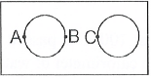
CW. If two rods of length L and 2L having coefficients of linear expansion α and 2α respectively are connected so that total length becomes 3L, the average coefficient of linear expansion of the composition rod equals
1. 2. 3. 4. None of these
CW. Two large holes are cut in a metal sheet. If this is heated, distances AB and BC, (as shown)
1. Both will increase 2. Both will decrease
3. AB increases, BC decreases
4. AB decreases, BC increases

Slide 114
THERMAL STRESS

Slide 115
Thermal Stress:
A metal rod is rigidly fixed at its ends so as to prevent it from expansion and contraction. When it is heated, thermal stress is developed in the rod.
Tension on the rod or thermal force,
A is area of cross-section of metal rod.
F = YAα(t₂ - t₁)
Yα(t₂-t₁)
Thermal Stress=Yα(t₂-t₁) where
α is coefficient of linear expansion of metal rod.
(t₂-t₁) is rise in temperature.

Slide 116
For same rise of temperature, if same thermal stress is developed in two different rods then Y₁α₁ = Y₂α₂.
If a cube of coefficient of cubical expansion γ is heated, then the pressure to be applied to prevent its expansion is given by,
P= Kγ (t₂ - t₁) or P = 3K α (t₂ - t₁)
α is coefficient of linear expansion

Slide 117
CW1. A force of 200 N is applied at one end of a wire of length 2 m and having area of cross- section 10⁻² cm². The other end of the wire is rigidly fixed. If coefficient of linear expansion of the wire α = 8x10⁻⁶ / ºC and Young’s modulus Y -2.2 x 10¹¹ N/m² and its temperature is increased by 5ºC, then the increase in the tension of the wire will be
1. 4.2 N 2. 4.4 N 3. 2.4 N 4. 8.8 N

Slide 118
CW2. A wire of cross-sectional area 3mm² is first stretched between two fixed points at a temperature of 20ºC. Determine the tension when the temperature falls to 10ºC. Coefficient of linear expansion α=10⁻⁵/ºC and Y = 2 x 10¹¹ N/m²
1. 20 N 2. 30 N 3. 60 N 4. 120 N

Slide 119
CW. A rod is fixed between two points at 20ºC. The coefficient of linear expansion of material of rod is = 1.1 x 10⁻⁵/ºC and Young’s modulus is 1.2 x 10¹¹ N/m² Find the stress developed in the rod if temperature of rod becomes 10ºC
1. 1.32 x 10⁷ N/m² 2. 1.10 x 10¹⁵ N/m²
3. 1.32 x 10⁸ N/m² 4. 1.10 x 10⁶ N/m

Slide 120
CW. Two rods of different materials having coefficients of thermal expansion α₁, α₂ and Young’s moduli Y₁,Y₂ respectively are fixed between two rigid massive walls. The rods are heated such that they undergo the same increase in temperature. There is no bending of the rods. If α₁ : α₂ = 2:3, the thermal stresses developed in the two rods are equal provided Y₁:Y₂ is equal to
1. 2:3 2. 1:1 3. 3:2 4. 4:9

Slide 121
SPECIFIC HEAT CAPACITY

Slide 122
SPECIFIC HEAT OR SPECIFIC HEAT CAPACITY:
The specific heat of a material is defined as the quantity of heat required by unit mass of the material to rise temperature by one degree.
Δ Q α m. Δ t
Δ Q = S m. Δ t
‘S’ is called the specific heat of the material of the body.

Slide 123
C.G.S unit : Cal gm⁻¹ / ⁰C
SI unit : J kg⁻¹ K⁻¹
1Cal/g ⁰C = 4186 J/kg K ≈ 4200 J/ kg K
1 Cal = 4.186 J
1 gm = 10⁻³ kg

Slide 124
The dimensional formula of specific heat is [M⁰ L² T⁻²K⁻¹] .
Specific heat depends only on nature of the substance. It does not depend on mass of the substance.

Slide 125
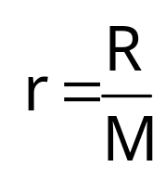
The ratio of universal gas constant per unit mass is called specific gas constant.
‘R’ same for all gases.
its value changes from one gas to another gas.
r = specific constant,
R = universal gas constant
‘r’

Slide 126
Heat capacity

Slide 127
HEAT CAPACITY OR THERMAL CAPACITY
The quantity of heat required to rise the temperature of a body through one degree is called heat capacity (H) of the body.
Let ΔQ be the quantity of heat given to the substance and let the rise in its temperature be Δt .
Heat capacity H =ΔQ/Δt

Slide 128
HEAT CAPACITY :
Units in C.G.S system : Cal/⁰C
SI units : JK⁻¹
Dimensional formula : [M⁰ L² T⁻²K⁻¹]

Slide 129
HEAT CAPACITY :
When some quantity of heat is given to the bodies of same mass but of different substance, it is observed that the rise in temperature is different for different substances.
So, the heat capacity of a body depends on the nature of the substance and also mass of the body.

Slide 130
RELATION BETWEEN HEAT CAPACITY (H) AND SPECIFIC HEAT (S).
When a quantity of heat ΔQ is given to a body of mass ‘m’. Let the rise in temperature of the body be Δt .
Then H = ΔQ/Δt ………….(1)
But specific heat S = ΔQ/m.Δt ……………(2)
ΔQ = m SΔt
From (1) & (2)
∴H = m SΔt/Δt
⇒ ∴H = mS.

Slide 131
CW. The amount of heat required to change the state of 1 kg of substance at constant temperature is called
1. Kilocal 2. Calorie
3. Specific heat 4. Latent heat
CW. Heat required to convert 1 g of ice at 0⁰C into steam at 100ºC is
1. 100 cal 2. 0.01 cal/⁰C
3. 720 cal 4. 1 kilocal

Slide 132
CW. The density of a material A is 1500 kg/m³ and that of another material B is 2000 kg/m³. It is found that the heat capacity of 8 volumes of A is equal to heat capacity of 12 volumes of B. The ratio of specific heats of A and B will be
1. 1:2 2. 3:1
3. 3:2 4. 2:1

Slide 133
WATER EQUIVALENT OF A BODY
The water equivalent of a body is defined as the mass of water which absorbs the same quantity of heat for same rise in temperature.
OR
The mass of water whose thermal capacity is equal to that of a given body is called water equivalent of that body.
Water equivalent of a given body,
Heat capacity of given body
W =
Specific heat of water

Slide 134
CALORIMETRY

Slide 135
CALORIMETRY
The branch of science which deals with the measurement of heat is called calorimetry.
A perfect calorimeter completely prevents heat from flowing to its surroundings.
At thermal equilibrium all the materials reach the same temperature.
The apparatus used for this purpose is called calorimeter.

Slide 136
Because no energy flows into or out of the container……...>>>>
The Law of conservation of energy leads to the principle of calorimetry.

Slide 137
PRINCIPLE OF CALORIMETRY
until they attain thermal equilibrium if heat is not lost by any other process
If two bodies at two different temperatures are brought into thermal contact,
Then heat is lost by the hot body and heat is gained by the cold body
heat lost by hot body=heat gained by cold body

Slide 138
Explanation:
Let t₃ be the common temperature attained
Heat lost by hot body=m₁s₁(t₁-t₃)
Heat gained by cold body=m₂s₂(t₃-t₂)
Consider a hot body of mass m₁
Specific heat S₁ at t₁⁰C is kept in thermal constant with another cold body of mass m₂ specific heat S₂ and at temperature t_{2.}

Slide 139
m₁s₁t₁- m₁s₁t₃ = m₂s₂t₃- m₂s₂t₂
t₃(m₁s₁+m₂s₂ )= m₁s₁t₁+ m₂s₂t₂
∴Common temperature
m₁s₁t₁+ m₂s₂t₂
t₃ =
m₁s₁+ m₂s₂

Slide 140
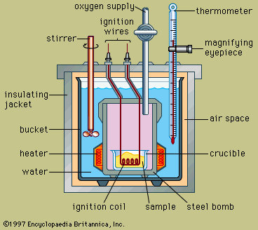

CALORIMETER

Slide 141
CW. One kg of ice 0⁰C is mixed with 1 kg of water 10ºC. The resulting temperature will be
1. between 0ºC and 10ºC
2. 0^{O}C
3. less than 0ºC
4. greater than 0ºC

Slide 142
CW. A small quantity, mass m, of water at a temperature θ (in ºC) is poured on to a large mass M of ice which is at its melting point. If c’ is the specific heat capacity of water and L the latent heat of fusion of ice, then the mass of ice melted is given by
1. 2.
3. 4.

Slide 143
CW. A block of ice with mass m falls into a lake. After impact, a mass of ice m/5 melts. Both the block of ice and the lake have a temperature of 0ºC. If L represents the heat of fusion, the minimum distance the ice fell before striking the surface is
1. 2. 3. 4.
CW. Some steam at 100ºC is passed into 1. 1 kg of water contained in a calorimeter of water equivalent 0.02 kg at 15 ºC so that the temperature of the calorimeter and its contents rises to 80ºC. What is the mass of steam condensing. (in kg)
1. 0.130 2. 0.065 3. 0.260 4. 0.135

Slide 144
CHANGE OF STATE:
MATTER
Solid
Liquid
Gas
These changes can occur when the exchange of the heat takes place between the substance and its surroundings.

Slide 145
LATENT HEAT:
The amount of heat absorbed or given out by unit mass of a substance during the change of state is called latent heat.
Liquids with low latent heat of vaporization are called volatile liquids.
Latent Heat L = Q/m
Units : Cal/gm or J / kg.
Ether and petrol are examples of volatile liquids.
Latent heat of fusion of ice is 3.35×10⁵ J kg⁻¹ or 80 Cal g⁻¹
Latent heat of vaporization of water is 2.26×10⁶ J kg⁻¹ or 540 Cal g⁻¹.

Slide 146
THREE PHASES OF MATTER

Slide 147
THREE STATES OF MATTER
The substances can exist in three states of matter i.e., solid, liquid and gas at different temperature and pressures.
Any phase of a substance can be changed into another phase on heating or cooling.
The process of converting one phase of a substance into another phase is called “phase change”.

Slide 148
For example when ice (solid phase of water) is heated, it melts and converts into water (liquid phase).
If water is cooled it freezes at 0⁰C and converts into ice.
Heated
Ice Water
Cooled

Slide 149
vaporization
liquid
gas
condensation
fusion
solid
liquid
Freezing
steam
solid
gas
sublimation

Slide 150
The process of changing the solid phase into the liquid phase is known as melting.
The process of changing the liquid phase into the gaseous phase is known as vaporization.
The process of changing the liquid phase into solid phase is called freezing or fusion.
The constant temperature at which the solid phase of a substance changes into a liquid phase is called the melting point of the substance.
The process of changing the gaseous phase into the liquid phase is called as condensation.

Slide 151
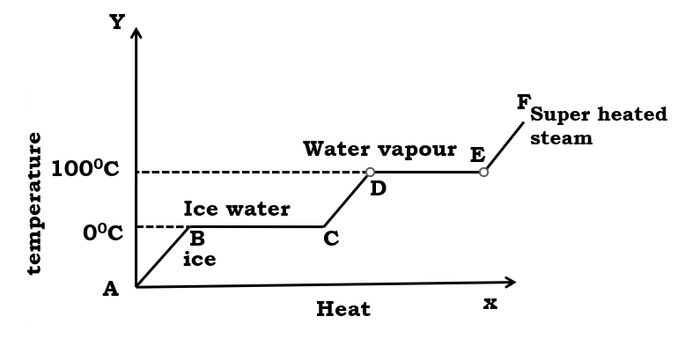

Slide 152
1) Melting → Heat supplied to the system
2) Vaporization or boiling→ Heat supplied to the system
3) Solidification or freezing→ Heat given out by the system
4) Condensation→ Heat given out by the system
5) Sublimation→ Heat supplied to the system
6) Hoarfrost→ Heat given out by the system

Slide 153
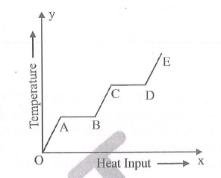
CW. A solid material is supplied with heat at a constant rate. The temperature of material is changing with heat input as shown in the figure. What does slope DE represent.
1. latent heat of liquid
2. latent heat of vapour
3. heat capacity of vapour
4. inverse of heat capacity of vapour

Slide 154
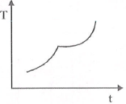
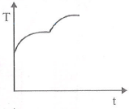
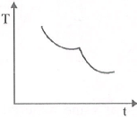
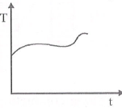
CW. An ice cube at temperature-20ºC is kept in a room at temperature 20ºC. The variation of temperature of the body with time is given by
1. 2.
3. 4.

Slide 155
TRIPLE POINT OF WATER

Slide 156
TRIPLE POINT OF WATER
DEFINITION:
The temperature and pressure at which three states (solid, liquid and vapour) of water are in thermal equilibrium is called triple point of water.

Slide 157
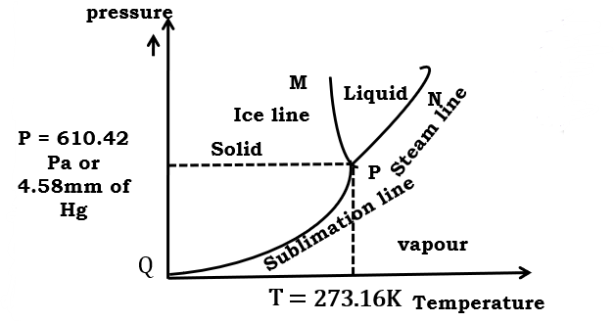
Co-ordinates of triple point of water = ( 273.16 K , 610.42 Pa)
All these temperatures change with pressure. So a phase diagram is obtained as shown in figure.

Slide 158
This can be observed in pressure cooker.
As slope of the curve QP is positive, it shows that the boiling point of steam increases with increase of pressure.
As the slope of the curve PM is negative, it shows that the melting point of ice decreases with increase of pressure.

Slide 159
  The curve PQ is called the sublimation line or hoarfrost line. Along the curve the ice and steam are in equilibrium.
The curve shows the variation of sublimation point with pressure.
All three lines PM, PN and PQ meet at a single point called triple point of water.
At the corresponding temperature and pressure, the three phases of water co-exist .

Slide 160
HEAT TRANSFER

Slide 161
Transfer of heat:
Heat is transferred from higher temperature to lower temperature region by three different processes.
Heat transfer
Radiation
Conduction
Convection

Slide 162
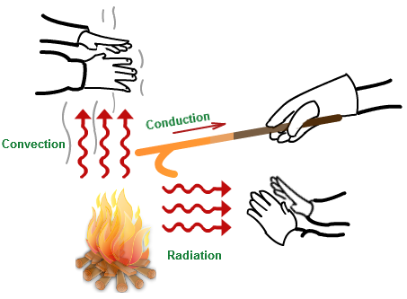

Slide 163
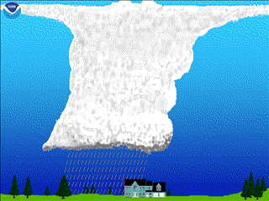
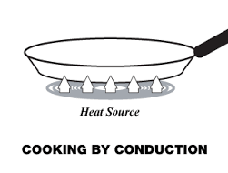
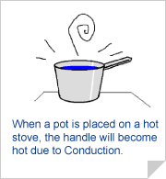
Conduction:
The process of transmission of heat energy from one place to another without movement of the particles of the medium is called conduction.
In this process heat transfer takes place by molecular vibrations .

Slide 164
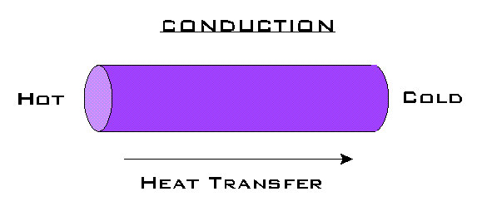
Coefficient of thermal conductivity:
In the steady state, the temperature at any point of a slab or rod does not change as time passes.
But along the slab or rod from high temperature end to low temperature end temperature decreases from point to point.
conduction
d
hot
Q/t
K
cold
θ₁
θ₂
Heat temperature

Slide 165
The change in temperature with distance is called temperature gradient.
θ₁-θ₂
Temperature gradient =
d
SI unit: K m⁻¹
Dimensional formula: [L⁻¹k].
Where θ₁ & θ₂ are temperatures of hot and cold ends.

Slide 166
Area of cross-section A
Heat flowing through each element of the slab is same in the steady state.
2. Temperature gradient =
P α A or P = KA
Where K is the coefficient of thermal conductivity of the material.
K depends on the nature of the material of the slab.

Slide 167
SI unit of K : Wm⁻¹K⁻¹
Dimensional formula K is [M L T⁻³k⁻¹ ].
In general, solids are better conductors than liquids and gases.
Their handles are wooden because wood is a bad conductor of heat.
For metals K = ∞
For insulators K = 0
Copper is used at the bottom of cooking utensils because it is a good conductor of heat.

Slide 168
Application of K:
The remaining sides are well insulated. The mass of ice that melts in time t is m.
Then Q=mL , θ₁ =100⁰ C, θ₂ =0⁰ C,
Substituting in
Where L is latent heat of fusion of ice.
A metal rod is kept at one end in a steam chamber and the other end is in ice at 0⁰C in steady state.
Where L is latent heat of fusion of ice.
L_{ice} = 80cal/g

Slide 169
Examples for conduction:
An iron chair and a wooden chair are placed in open space during a winter night.
Silver is the best conductor of heat
because the air layer present between the two panes has very low thermal conductivity when compared with single glass.
Their handles are made of wood because wood is a bad conductor of heat

Slide 170
Copper is used at the bottom of cooking utensils because it is a good conductor of heat.
Rate of flow of heat into a room is lesser by replacing a single glass pane window with a double glass paned window
When we touch it we feel that the iron chair is colder than the wooden chair because the conductivity of iron is greater than wood.

Slide 171
HEAT FLOW THROUGH SLAB IN SERIES

Slide 172
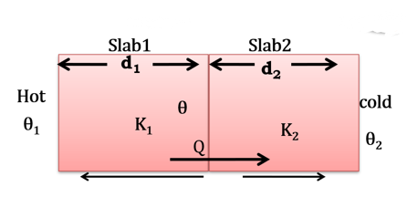
Heat flow through slabs in series:
θ₁ and θ₂ are the temperatures of outer surfaces of the two slabs and θ be the temperature of interface.
Two slabs of thickness d₁ and d₂ and thermal conductivities K₁ and K₂ are kept in contact.

Slide 173
……… (1)
In the steady state, the amount of heat conducted per unit time will be same.
or
……… (2)
……… (3)
……… (4)

Slide 174
K₁, K₂, K₃……. K_{n}, are kept in contact, heat conducted in the steady state is

Slide 175
Junction temperature:
Q is same through slabs 1 and 2 in the steady state.
Temperature of the interface,
K₁d₂θ₁ - K₁d₂θ
=
K₂d₁θ - K₂d₁θ₂
If d₁= d₂ then

Slide 176
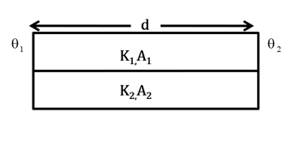
Heat flows through slabs in parallel:
and the thermal conductivities K₁, K₂, K₃ … K_{n} are connected in parallel between the temperature zones of θ₁,θ_{2.}

Slide 177
In the steady state, heat conducted through slab 1 in time t is
The total heat conducted through n slabs in time t is
Q = Q₁ + Q₂ + Q₃ + ........... Q_{N}

Slide 178
THERMAL RESISTANCE OF A CONDUCTOR

Slide 179
Thermal resistance of a conductor:
Thermal resistance R of a conductor of length d, cross-section A and conductivity K is given by d/KA.
SI unit → KW⁻¹
Dimensional formula = M⁻¹L⁻²T³K
The heat current Q/t is taken as i, so that,
Here, the temperature difference is identical to potential difference V of a conductor and the above relation is identical to the electric current.

Slide 180
R = R₁+R₂+R₃…….
Where K is the equivalent thermal conductivity of series combination.
When a number of slabs are placed in series, the equivalent thermal resistance is

Slide 181
Note:
For two slabs
If d₁ = d₂ ,

Slide 182
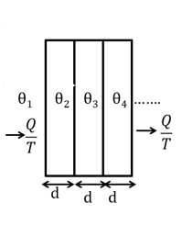
If the temperature of the faces of the slabs is as shown in the figure,
If n slabs are in parallel, the equivalent thermal resistance is given by
Then the temperature difference between the outer faces of the first and last slabs is

Slide 183
Where K is the equivalent thermal conductivity in parallel combination.
If two slabs are such that A₁ = A₂

Slide 184
CW. If two metallic plates of equal thickness and thermal conductivities K₁ and K2are put together face to face and common plate is constructed, then the equivalent thermal conductivity of this plate will be-
1. 2. 3. 4.
CW. The ratio of thermal conductivity of two rods of different material is 5:4. The two rods of same area of cross-section and same thermal resistance will have the lengths in the ratio
1. 4:5 2. 9:1 3. 1:9 4. 5:4

Slide 185
CW. Wires A and B have identical lengths and have circular cross-sections. The radius of A is twice the radius of B i.e. r_{A}= 2r_{B}. For a given temperature difference between the two ends, both wires conduct heat at the same rate. The relation between the thermal conductivities is given by
1. K_{A}=4K_{B} 2. K_{A}=2K_{B}
3. K_{A} =K_{B}/2 4. K_{A} =K_{B/4}

Slide 186
CW.A wall has two layers A and B, each made of different material. Both the layers have the same thickness. The thermal conductivity for A is twice that of B. Under steady state, the temperature difference across the whole wall is 36ºC. Then the temperature difference across the layer A is
1. 6ºC 2. 12ºC 3. 18ºC 4. 24ºC

Slide 187
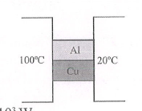
CW. Two metal cubes with 3 cm-edges of copper and aluminum are arranged as shown in figure
(K_{CU} = 385 W/m-K,K_{AL} =209 W/m-K)
The total thermal current from one reservoir to the other is
1. 1.42 x 10³W 2. 2.53 X 10³ W
3. 1.53 x 10⁴W 4. 2.53 x 10⁴W
(b) The ratio of the thermal current carried by the copper cube to that carried by the aluminium cube is
1. 1.79 2. 1.69 3. 1.54 4. 1.84

Slide 188
CW. One end of a 2.35m long and 2.0cm radius aluminium rod (K=235 W.m⁻¹K⁻¹) is held at 20ºC. The other end of the rod is in contact with a block of ice at its melting point. The rate in kg. s⁻¹ at which ice melts is [Take latent heat of fusion for ice as x10⁵ J.kg⁻¹]
1. 48 x 10⁻⁶ 2. 24 x 10⁻⁶
3. 2.4 x10⁻⁶ 4. 4.8 x 10⁻⁶

Slide 189
CW. Four rods of same material with different radii r and length/are used to connect two reservoirs of heat at different temperatures. Which one will conduct most heat?
1. r = 2cm, l = 0.5m 2. r = 2cm, l = 2m
3. r = 0.5cm, l = 0.5m 4. R = 1cm. l = 1m

Slide 190
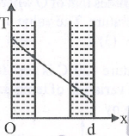
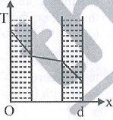
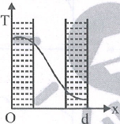
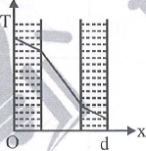
CW. The wall with a cavity consists of two layers of brick separated by a layer of air. All three layers have the same thickness and the thermal conductivity of the brick is much greater than that of air. The left layer is at a higher temperature than the right layer and steady state condition exists. Which of the following graphs predicts correctly the variation of temperature T with distance d inside the cavity?
1. 2. 3. 4.

Slide 191
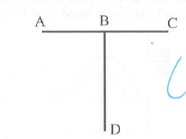
CW. Three conducting rods of same material and cross-section are shown in figure. Temperatures of A,D and C are maintained at 20ºC, 90^{O}C. The ratio of lengths of BD and BC if there is no heat flow in AB IS
1. 2/7 2. 7/2 3. 9/2 4. 2/9

Slide 192

CW. Six identical conducting rods are joined as shown in figure. Points A and D are maintained at temperature of 200ºC and 20ºC respectively. The temperature of junction B will be
1. 120ºC 2. 100ºC 3. 140ºC 4. 80ºC

Slide 193
CW. Two sheets of thickness d and 3d, are touching each other. The temperature just outside the thinner sheet side is A, and on the side of the thicker sheet is C. The interface temperature is B.A,B and C are in arithmetic progressing, the ratio of thermal conductivity of thinner sheet and thicker sheet is
1. 1:3 2. 3:1 3. 2:3 4. 1:9
CW. Spheres P and Q are uniformly constructed from the same material which is a good conductor of heat and the radius of Q is thrice the radius of P. The rate of fall of temperature of Pis x times that of Q when both are at the same surface temperature. The value of x is
1. ¼ 2. 1/3 3. 3 4. 4

Slide 194
CONVECTION

Slide 195
Convection:
The process of heat transfer from one place to other by actual movement of particles of medium due to difference in density is called convection.
Convection
Convection is predominant in liquids.
Natural convection
Forced convection
The rate of heat flow (P = Q/t) is directly proportional to the area A and temperature difference (Δθ).

Slide 196
P α A Δ θ
∴P = hA Δ θ
Where A is the surface area over which fluid moves and h is the coefficient of convection.

Slide 197
Natural Convection:
Transfer of heat due to the movement of fluid resulting from the differences in density is called natural convection.
Examples:
Hot air rises by natural convection.
Sea breeze.
Land breeze.

Slide 198
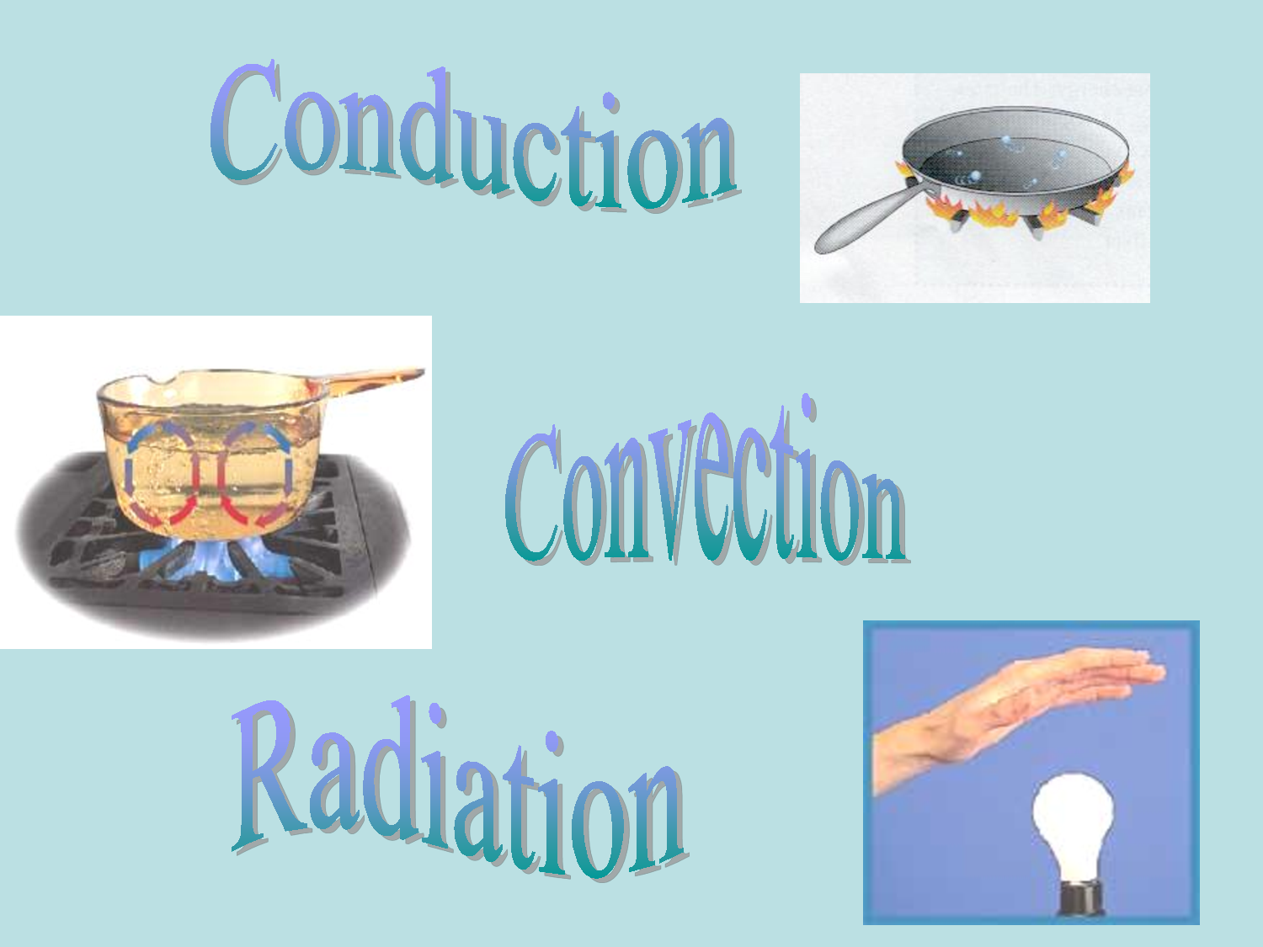
When a vessel containing water is placed on a fire then, water is heated by natural convection.

Slide 199
Forced convection:
Transfer of heat due to the forced movement of the fluid by mechanical means, such as a fan or pump, is known as forced convection.
The hot air in contact with the radiator of a car will be thrown away by forcing air using a fan.
Ventilation in houses is an example for forced convection.
Examples:
Cooling rooms in summer by pumping cold air by mechanical means (air coolers).
Exhaust fans drive out the hot air from an auditorium or a big crowded hall.

Slide 200
RADIATION

Slide 201
Radiation:
The process of transmission of heat from one place to another without the necessity of the materialistic medium is called radiation.
The radiation by virtue of its temperature is thermal radiation.
In this process heat transmits in the form of electromagnetic radiation.
All bodies emit thermal radiation except at absolute zero.

Slide 202
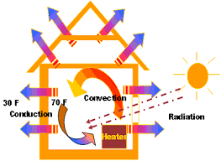

Examples for radiation:

Slide 203

Thank you…

